Slide 1
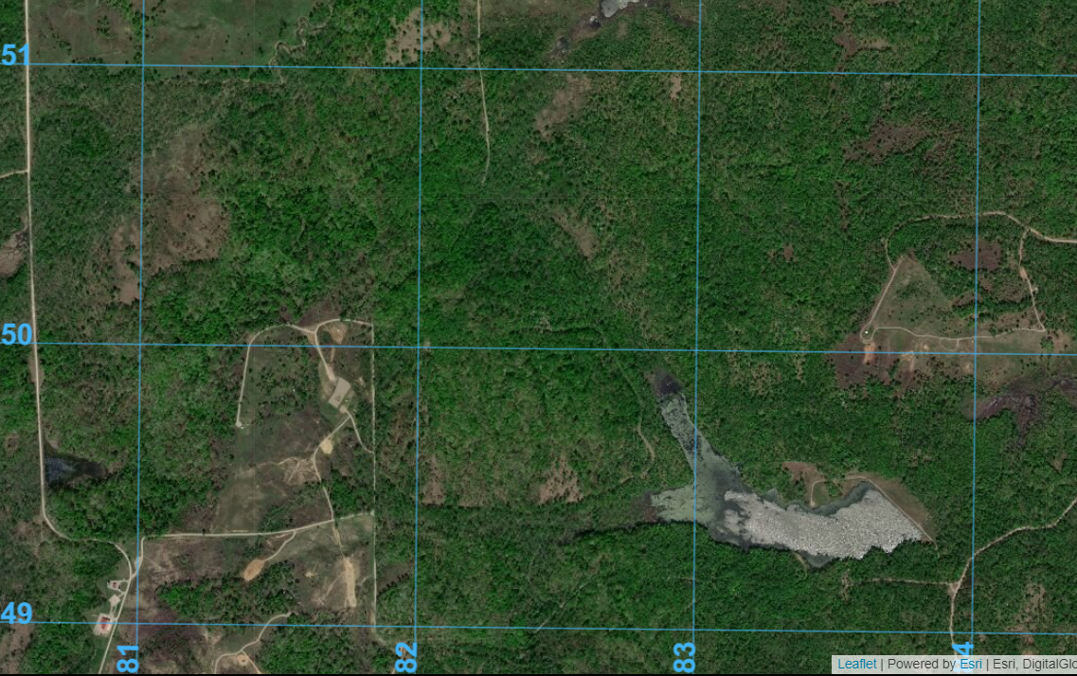
AO IRISH
Objective
Boston
VDO
LU

Slide 2
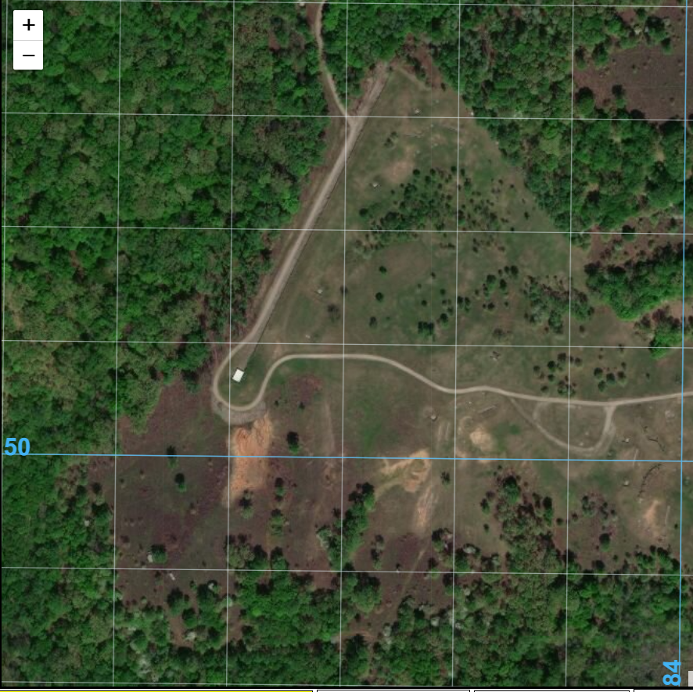
OBJ BOSTON

Slide 3
Situation
Enemy: SAPA forces occupied a new command post in AO Irish 48 hours ago IOT coordinate attacks on 1st Battalion. Their intent is to disrupt further advances southward toward the Ariana/Atropian border to enable Arianan forces to reconsolidate for counterattack. They will accomplish this by attacking sustainment formations and destroying critical infrastructure (roads, bridges, powerlines, etc). The Command post consists of a small command and staff element (3-4 individuals), likely in the hard-stand structure, and a dismounted infantry squad in the vicinity for security. In the past 48 hours, SAPA forces in AO Irish have been supported by 82 mm mortars.

Slide 4
Execution
Task to subordinate unit: Your PLT, 1st PLT, C Company, 1st Cadet Battalion attacks to destroy SAPA command post IVO OBJ Boston NLT 1900 IOT neutralize enemy mission command capabilities in AO Irish.
C Co Headquarters transports 1st Platoon to Vehicle Drop Off (VDO) point NLT 1500. Ground convoy departs C Co assembly area NLT 1430.
1st PLT is first in priority of fires. Plot and brief 2 60mm mortar targets and 1 81mm mortar target.
Collect orders, operations overlays, and signal operating instructions (SOI). Destroy communications equipment and weapons on the OBJ prior to withdrawal.
Proceed to the linkup point south of OBJ Boston upon completion of the attack. Linkup point is also the company ambulance exchange point (AXP)

Slide 5
Outputs
In 20 minutes, develop the following:
Route from the VDO to OBJ Boston
Scheme of maneuver for the attack. Include:
Locations of all elements prior to initiating the attack.
Basic fire control measures. How do you intend to control fires to maximize effects and mitigate fratricide (ie. Target Reference Points [TRPs], phase lines, restrictive fire lines, etc).
Withdrawal plan
Scheme of fires. Include:
For each target- trigger/location/observer/delivery system/attack guidance/communications net. (see Ranger Handbook pg. 3-9)

