Slide 1
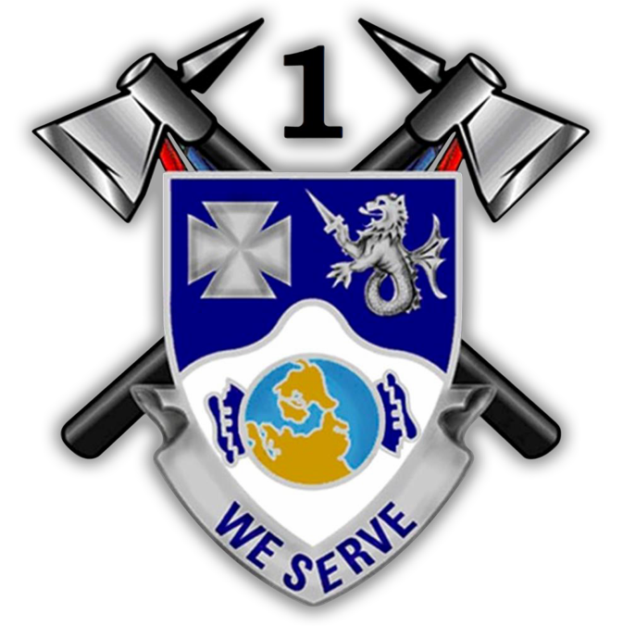
Apache Leader Development Process
CPT THOMAS E. MEYER
1SG ANDREW F. HUTZENBILER

Slide 2
Apache Leader Development Process
Education/ Institutional Domain
We are mentally/ intellectually prepared.
Providing our leaders the opportunity to attend Army centers and schools that provide functional training and professional education. Reinforcing operational domain skills as part of their leadership development; specifically in the areas that reinforce situational awareness, resilience, and comprehensive fitness.
Training/ Operational Domain
Training keeps our tomahawks scoured.
This is where leaders do the bulk of their development encompassing training and education. Junior leaders will achieve technical and tactical competence, operational leadership, and strategic impacts.
Experience/ Self-Development Domain
The braids represent our wisdom through experience.
Within the Individual Domain we will challenge our leaders by sparking interest in self-development and providing them interesting mechanisms and resources through the MTC LT&D that facilitate personal and professional growth.
The Apache Leader Development Process builds agile, adaptive, and critically thinking leaders of character by linking experiential learning (which drives areas of needed study) and self study (which prepares leaders for future positions) in order to invest in the most critical resource to our nation – leadership.
END STATE: Apache leaders are empowered to embrace mission command, take disciplined initiative, and are ready to deploy to support the requirements of the combatant Commander. Leaders have the tools and understanding to thrive in complex, ambiguous environments and are comfortable with decentralized operations. Our leaders exhibit moral character and sustain the trust of the Soldiers they lead.

Slide 3
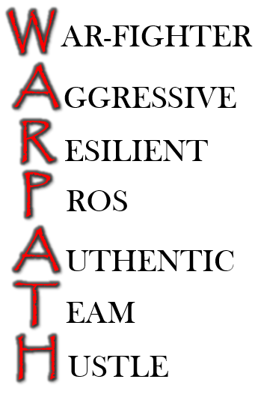
Ends, Ways, and Means
ON THE WARPATH!
EVENT
AUDIENCE
Initial/Performance Counseling All Apache Soldiers
Monthly Counseling/Home Visits PL, PSG, SL
Develop
Technical/Tactical Quizzes PL, PSG, SL
Apache Leaders Are...
…Founded on our Shared Values - Character
…Technically and Tactically Proficient
….Physically, Mentally, and Emotionally Resilient
…Agile & Adaptive Thinkers
…Life-long Learners
SHARED VALUES
Apache Reading List XO, PL, Optional for PSG, SL
Community Service All Apache Soldiers
MRT/MFT PL, PSG, SL
Principles of Mission Command XO, PL, PSG
Teach
TED Talks & Podcast Discussion PL, PSG, SL
Leader Roles and Responsibilities PL, PSG, SL
Officer Reading Discussions All Apache Officers
ICATS XO, PL, PSG
EIB All Apache Soldiers
Train
Deployment Schools All Apache Soldiers
8-Step Training Model PL, PSG, SL
Apache Tactical Athlete Program All Apache Soldiers

Slide 4
Course Overview
The ALDP balances instruction, discussion, and practical exercise in the art of leadership and the science of war. It is aligned with our shared values and command philosophy and in direct contribution to our focus on being pros in the crucible of armed combat for the purpose of winning wars.
Organizational Leadership
The Profession of Arms
Starfish and the Spider (Read & Discuss)
Nick Saban Interview (Watch/Discuss)
Good to Great (Read & Discuss)
Simon Sinek TED Talk
The Ideal Team Player (Read & Discuss)
Psyched Up
Daniel Pink TED Talk
Hay in the Barn Readings
Podcast Series
LT Lunch
360 Degree Evaluations
Myers-Briggs Personality Test
2017 Leader Summit
Baseline Comprehensive Test
Operations (Read, Quiz, Discuss)
ADP 3-0
ADP 3-90
ADP 5-0
OPORD Development
Troop Leading Procedures
Build Briefing Boards
OPORD – Practical Evaluation
8 Hour OPORD Exercise
Brief
Offensive Operations (ADRP 3-90)
Read, Discuss, Quiz
Defensive Operations (ADRP 3-90)
Read, Discuss, Quiz
Stability Operations (ADRP 3-07)
Read, Discuss, Quiz
Comprehensive Exam
Tactical Decision Games
Legal / UCMJ LPD
The SBCT: How We Fight &
Train
Shared Values & Vision
Leadership (Read, Quiz, Discuss)
ADP 6-0
ADP 6-22
ADP 7-0
Maneuver Self Study
A6 Company Grade Reading List
White Papers
TLM 2.0
Once an Eagle
“Real education presupposes a sense of proportion in physical, mental, and moral development; and that he alone is educated who has learned the lessons of self-control and open-mindedness.”

Slide 5
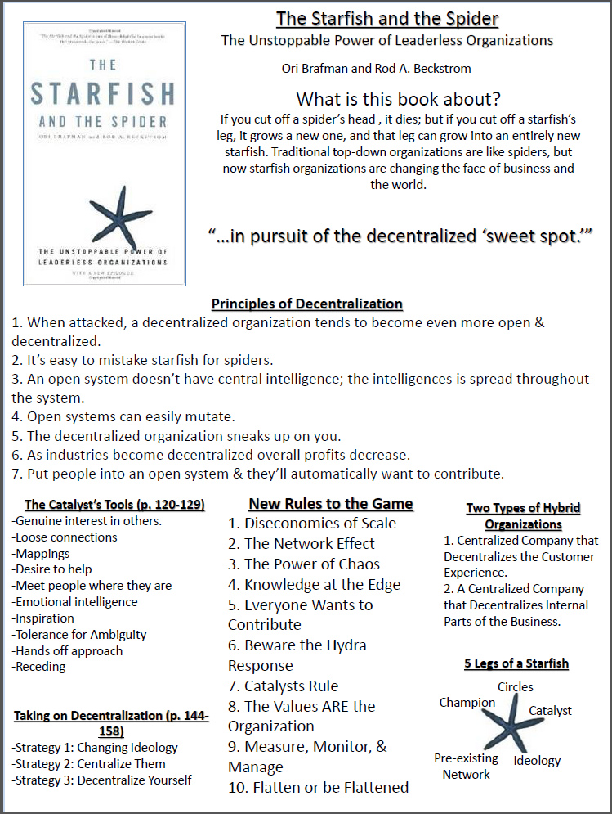
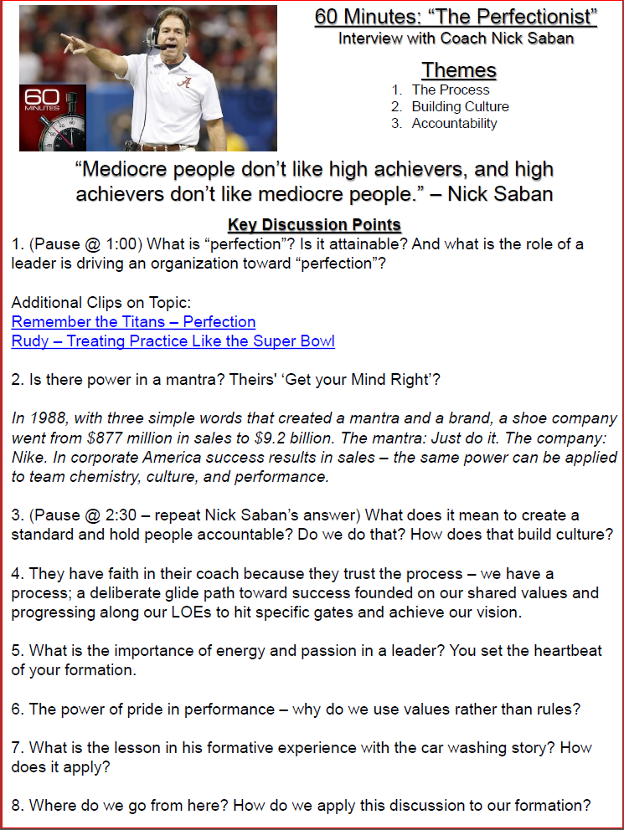
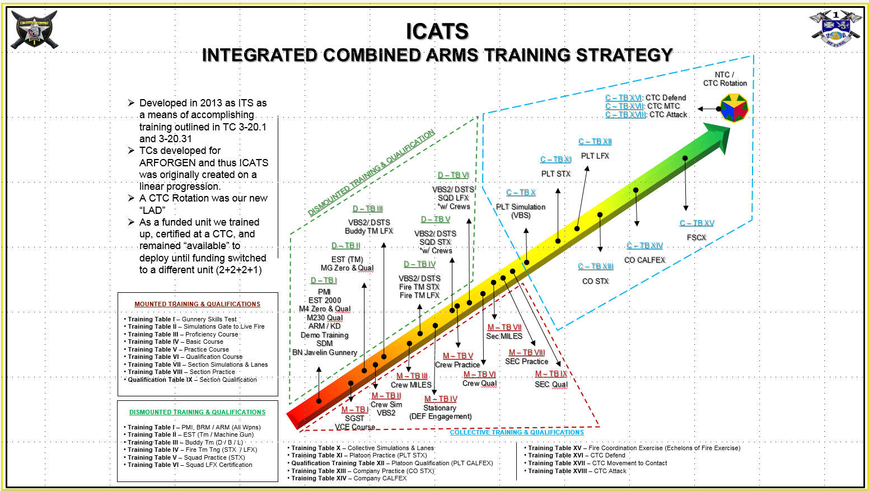
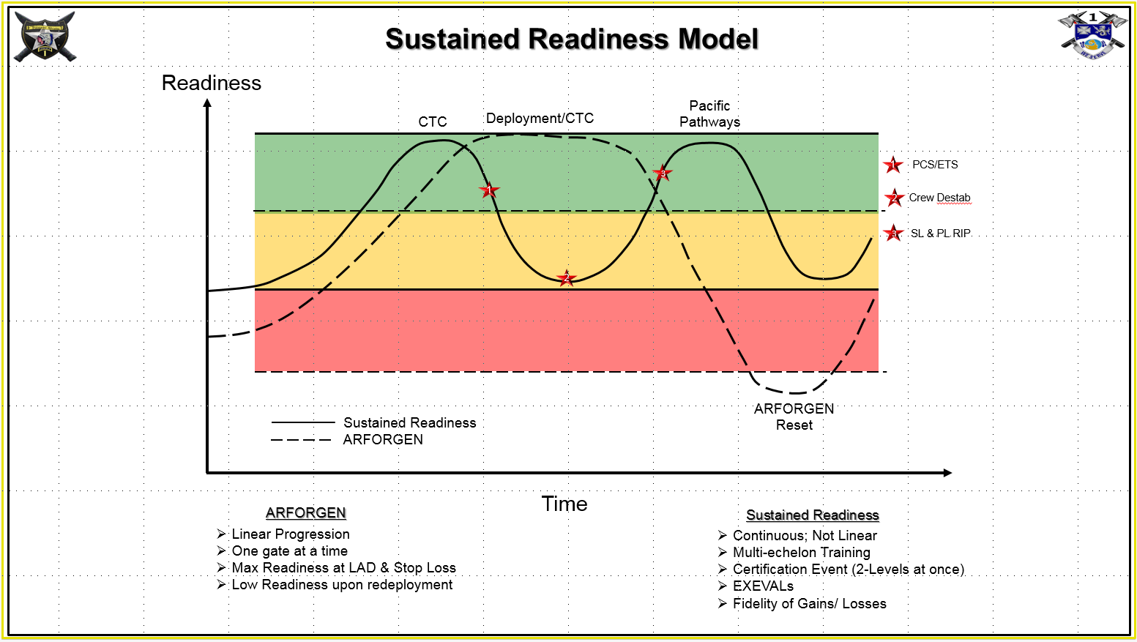
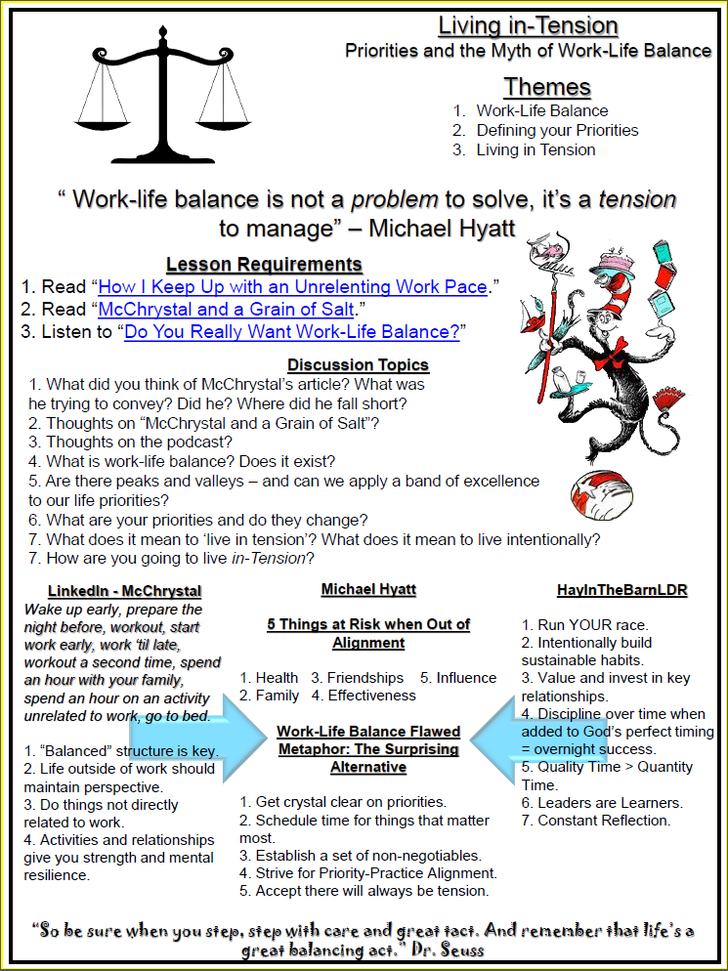
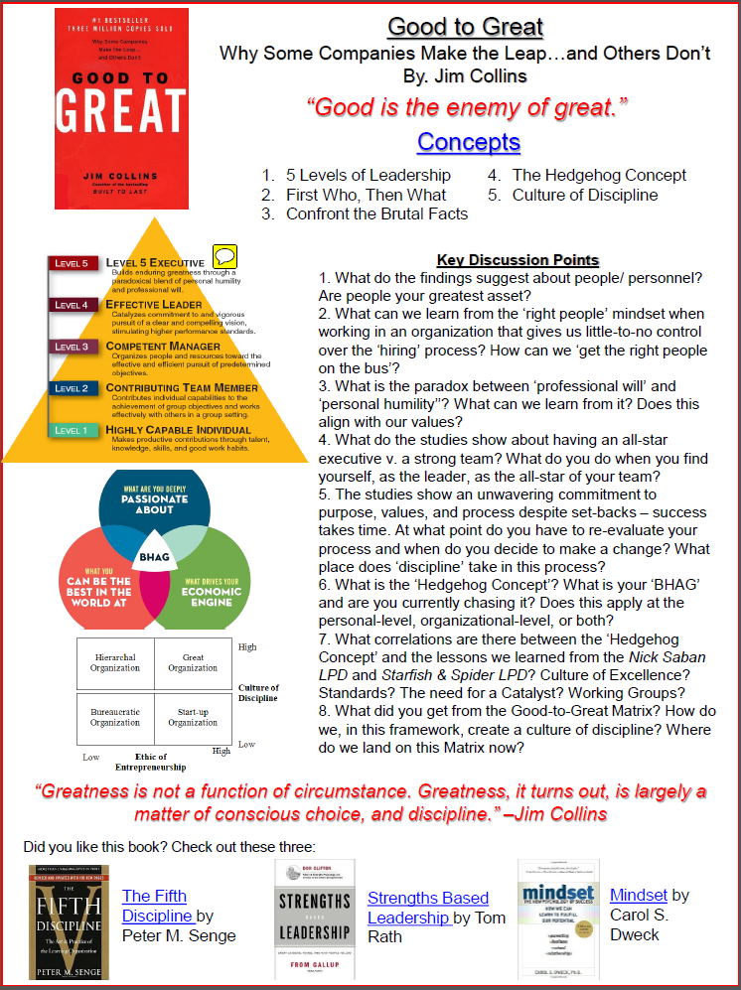
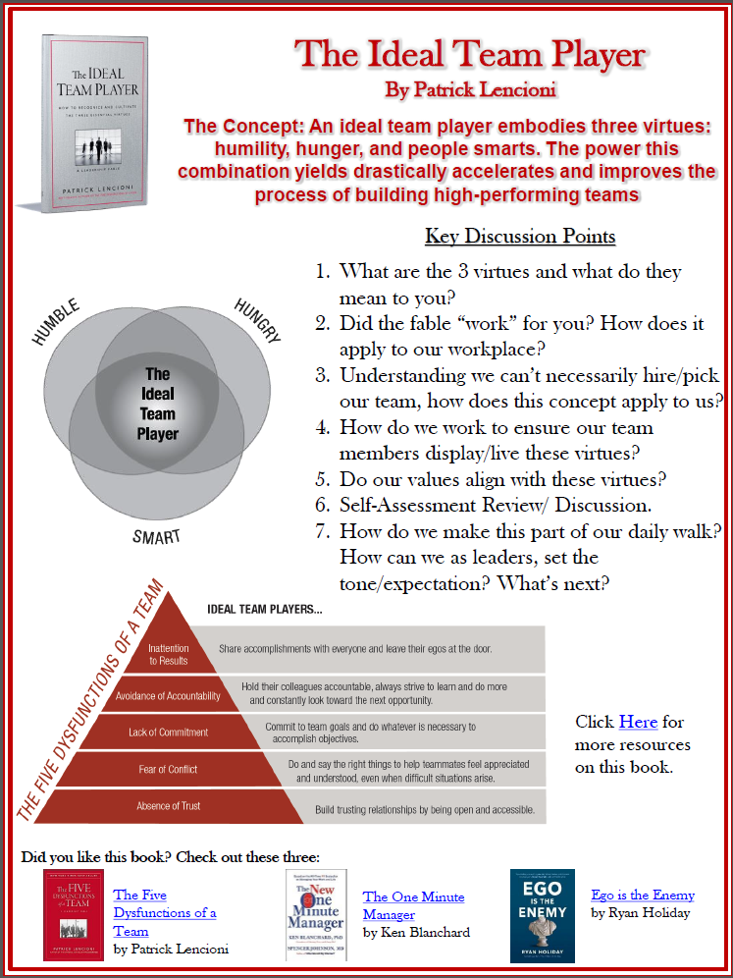
ALDP: The Value of Dialogue
The Apache Leader Development Process
PROCESS; not a program
Builds agile, adaptive, and critically thinking leaders of character
Connects our shared values to our ends and ways
Develops cognitive abilities; how + why > what
Marries the Art of Leadership to the Science of Tactical Application and their Strategic Impacts
Promotes the Profession of Arms – contributes to the canon
The Starfish & the Spider
How We Fight & Train
Nick Saban “The Perfectionist”
Living In Tension
Good to Great
The Ideal Team Player
Psyched Up
Notes:
Do the Things Only You Can Do:
CDR:
Set the emotional tone of the Company.
Keep us focused on our Vision & Values.
Shape operations at the BN & BDE-level.
Leader Development of our Officers.
Communicate & Develop the Apache Brand – On the Warpath!
The conversation after the script is where the greatest gains are found – talking with them grows me; Arts/ Social Sciences guy with a Criminal Justice LT and three STEM LTs.
Low cost, HIGH impact – all you need is curiosity, information, genuine care, and a white board w/ marker

Slide 6
Discussion Based LPDs
MTC Leader Training & Development
http://www.ted.com/search?q=Leadership
Video Library
Document Library
Requested Training
TED Talks
SLA Marshall Combat Leader Videos
Combat Accounts
Leaders on Leadership
Decision Making Exercises
Leadership Physiology
Mission Command
Leadership in the News
Critical Thinking
Communication Skill
Understanding Human Behavior
Combat Leader Interview Program
Customized Leadership Training
Decision Making Exercises
Facilitated Discussions on Leadership
Simon Sinek “How Great Leaders Inspire Action”
Brene Brown “The Power of Vulnerability”
Dan Pink “The Puzzle of Motivation”
David Logan “Tribal Leadership”
Drew Dudley “Everyday Leadership”
Simon Sinek “Why Good Leaders Make You Feel Safe”
SMALL GROUP DISCUSSION
GUIDED DISCUSSION LINKED TO RELEVANCY & A PLAN OF ACTION

